Slide 1
Introduction to C++
Prateek Pudasainee

Slide 2
Contents
Introduction
Limitations of structural programming. (C programming)
OOP(Object Oriented Programming).
C++, its history and its applications.
Characteristics of C++.
Difference between C and C++.
Data Types And Operators.
Conditional Operators.

Slide 3
Limitations of structural programming.
In C, data is exposed globally unless explicitly restricted, increasing the risk of accidental modification, unlike OOP, which uses encapsulation for data protection.
Structural programming does not support inheritance, meaning code has to be rewritten for similar functionalities, making maintenance difficult.
As a program grows, procedural C can become difficult to manage due to a lack of modularity, leading to complex and hard-to-debug code.
C lacks features like polymorphism and dynamic method binding, making it harder to extend functionalities without modifying existing code.

Slide 4
OOP
OOP is a programming paradigm that organizes code into objects rather than functions and logic.
Organizes code into objects and classes, while structural programming uses functions and procedures.
It is better for large, complex projects, while structural programming is simpler and suitable for small programs.
It follows four main principles: Encapsulation, Abstraction, Inheritance, and Polymorphism to enhance code reusability and maintainability.

Slide 5
C++ , History and Applications
C++ is a high-level, general-purpose programming language that extends the C language by adding object-oriented programming (OOP) features like classes and objects.
Developed by Bjarne Stroustrup in the early 1980s as an extension of the C language.
Initially called "C with Classes", later renamed C++ in 1985.
Combines procedural programming (from C) with object-oriented programming.
C++ is known for its powerful performance and efficiency, offering fine-grained control over system resources while providing modern features like OOP, templates, and the Standard Template Library (STL).

Slide 6
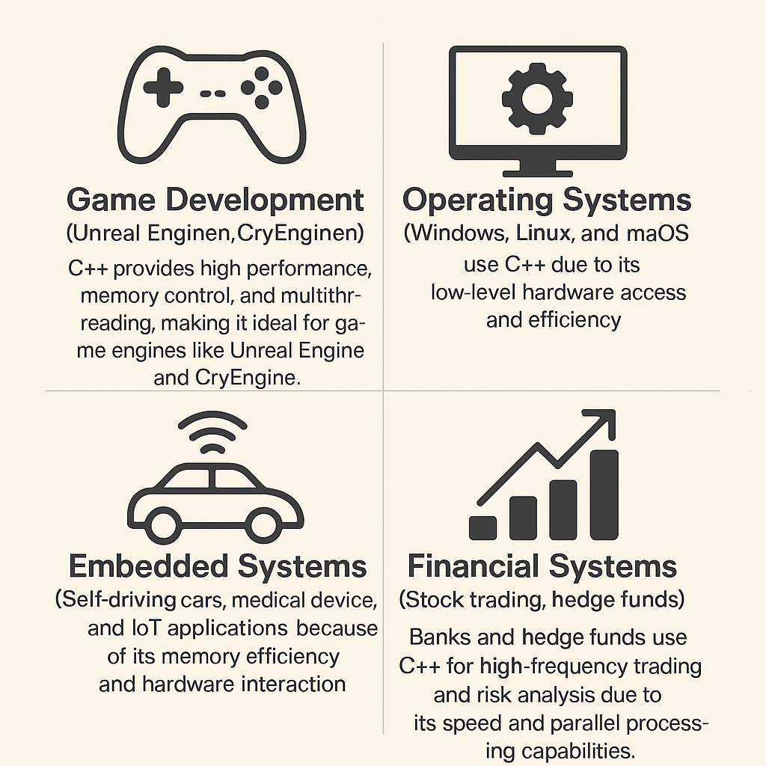

Slide 7
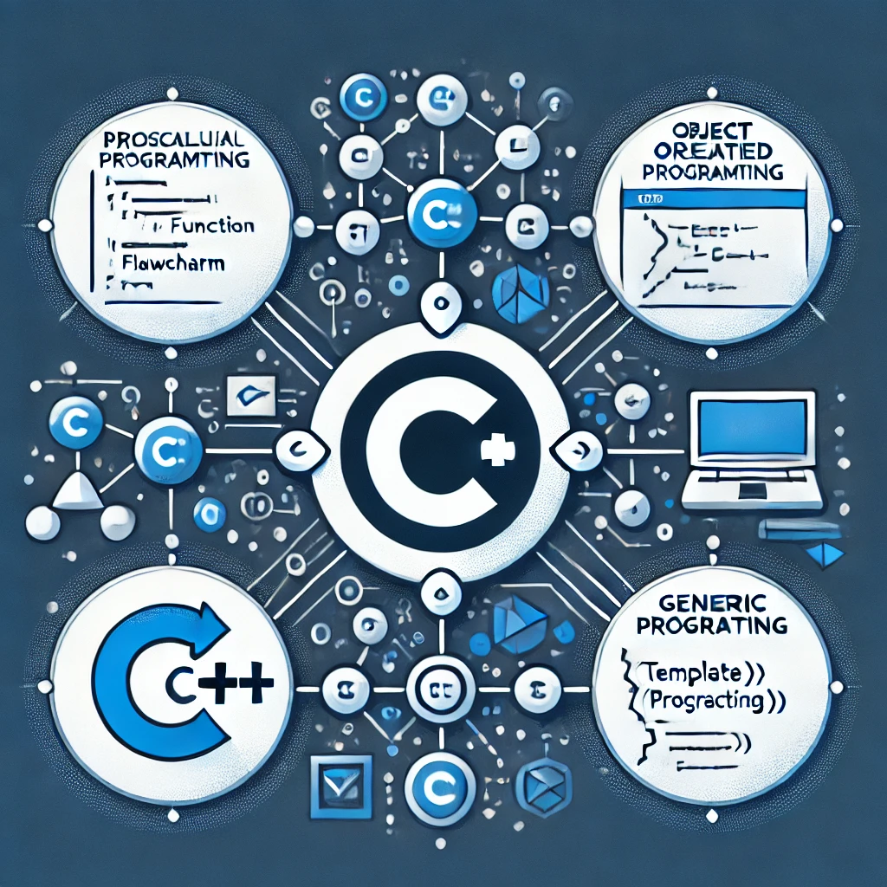
Characteristics of C++
Multi-Paradigm Language: C++ supports procedural, object-oriented, and generic programming, allowing developers to choose the best approach for a given problem.
Compiled & High-Performance: C++ is a compiled language that directly translates code into machine language, ensuring fast execution and high performance.

Slide 8

Low-Level Memory Control: Provides direct control over memory with pointers and dynamic allocation, allowing developers to optimize resource usage.
Rich Standard Library (STL): The Standard Template Library offers a collection of reusable, efficient data structures and algorithms to simplify development.
Platform Independent: C++ code can be executed across various operating systems (Windows, Linux, macOS) with minimal or no modifications.

Slide 9

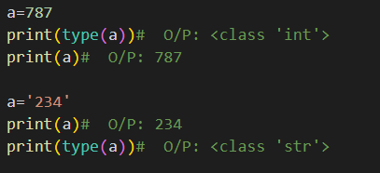
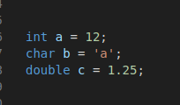
Multi-threading Support: C++ supports multi-threading, allowing the creation of programs that can run multiple operations simultaneously, improving performance in parallel tasks.
Strongly Typed: C++ requires explicit type declarations, which reduces the likelihood of type-related errors and increases program reliability.
Strong typing
Weak typing

Slide 10
Object-Oriented Programming (OOP): C++ enables encapsulation, inheritance, polymorphism, and abstraction to organize code and model real-world objects.
Extensible & Scalable: Whether building small applications or large systems like game engines and operating systems, C++ scales efficiently to meet project needs.
Backward Compatibility: C++ maintains compatibility with C, enabling seamless integration with C libraries and codebases.

Slide 11
